Slide 1


1) Please sign-in in the “Chat Box”
Welcome to the LARC
LS #3
2) Please rename yourself with your site location code and actual name / facility name
Site | Location Code
BRIDH | BRIDH
Budiriro | BUD
Chitungwiza | CHIT
Epworth | EP
Hatcliffe | HC
Hopely | HOP
Kwadzana | KWAD
Mbare | MBA
NMRL | NMRL
Overspill | OS
Pari | PARI
PSI Lab | PSI
Seke North | SN
St. Marys | SM
Zengeza | ZEN

Slide 2
6 Simple Steps
to Change your Name in the Zoom Participant List

Slide 3
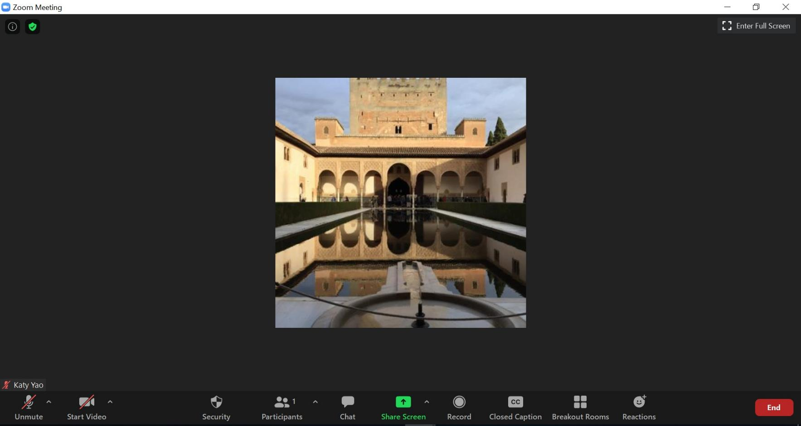
Step 1 – Click Participants (by the chat box) at the bottom of the screen

Slide 4
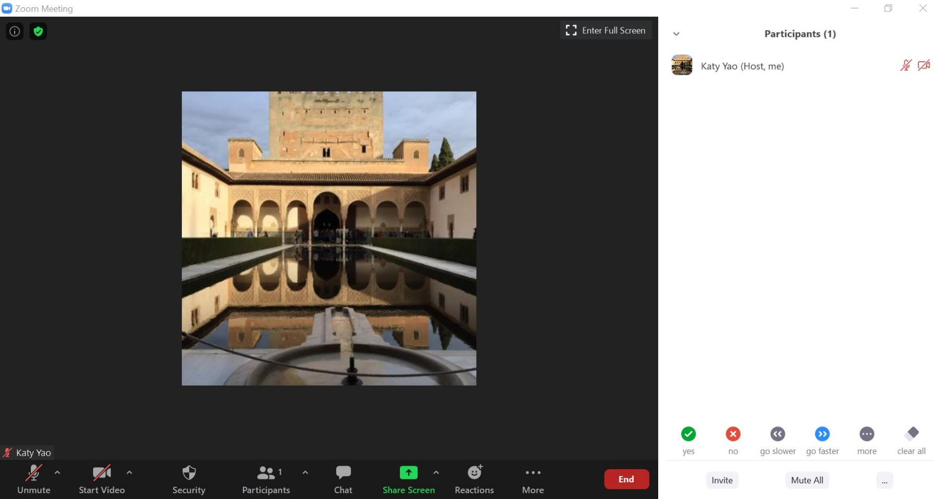
Step 2 – Participant panel opens. Find your name.

Slide 5
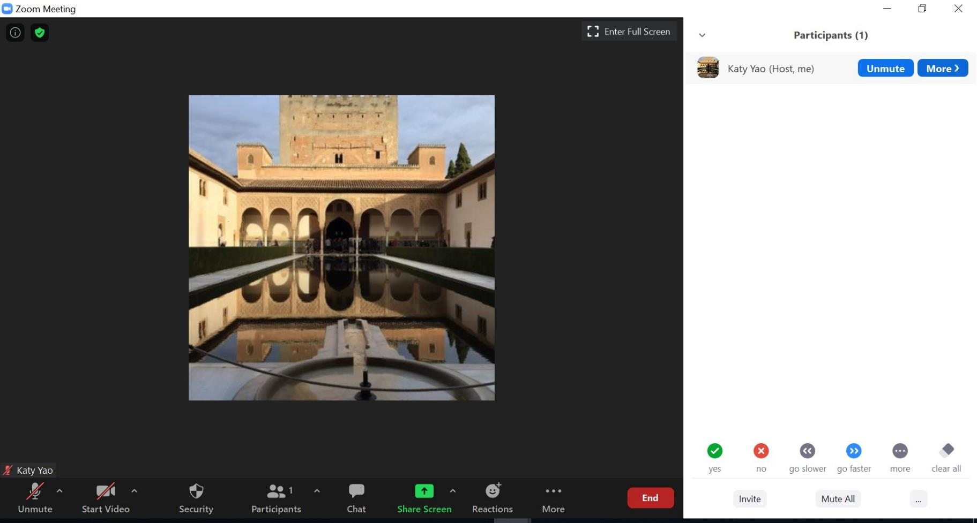
Step 3 – Put cursor by your name and click More

Slide 6
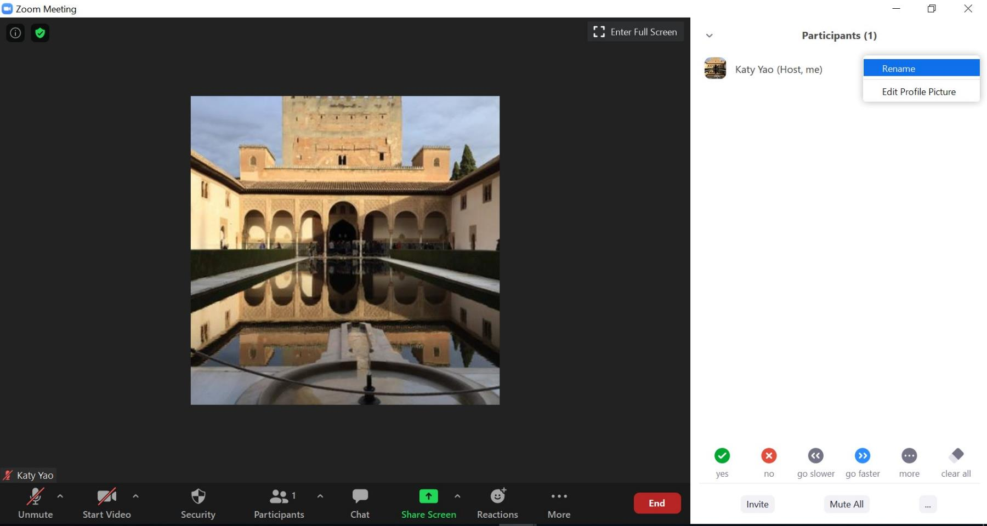
Step 4 – Click Rename

Slide 7
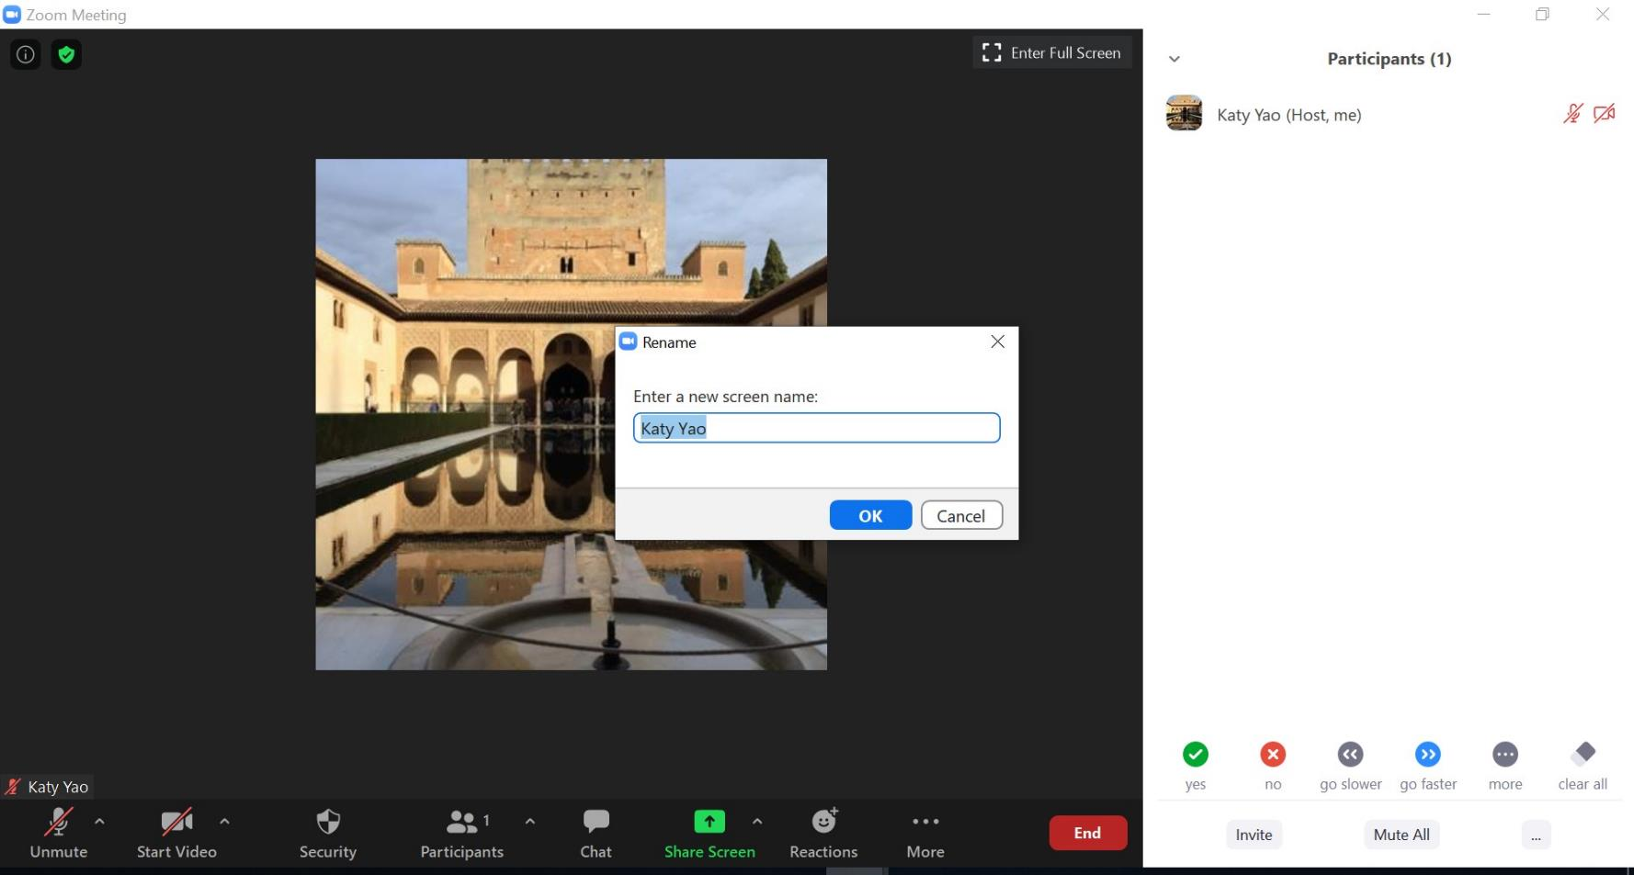
Step 5 – Type a new name in the Rename box

Slide 8
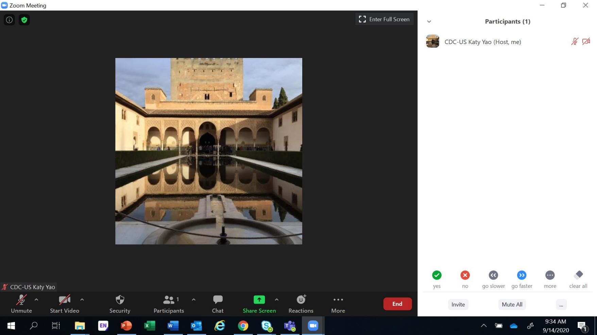
Step 6 – You have now changed your name in the Participant List

Slide 9


It’s HERE
On Your Screen
LS #3 – September 14-16

Slide 10
Welcome

Slide 11
Introductions

Slide 12


Turn on Your Camera
Smile
Wave
Let us see your smiling face

Slide 13


Slide 14


Begin with the End in Mind

Slide 15

Aim #3: Improve
Viral Load Coverage

Slide 16


GOAL:
Be ready to begin testing CHANGES on September 17

Slide 17

Select a CHANGE to test
VOC
RCA
OFI
Deliverables for LS #3
Detailed PDSA Worksheets
Data Collection Plan

Slide 18


PAGER – Monday, September 14
Purpose:
To provide a guided approach to QI Initiative Aim #3 – Viral Load Coverage
  Define / Measure / Analyze / Improve Phase – CHANGE Menu, CHANGES Tested = PDSA
Agenda:
Data Collection Exercise Debrief CHANGE Menu Presented CHANGE Selected
PDSA Plan
Data Collection Demonstration
Ground Rules:
Begin & end on time, Respect for all persons & all thoughts, Encourage engagement & participation,
Keep audio on mute unless speaking / Raise hand to share or put question in chat box
Expected Outcomes:
Deliverables:
  CHANGES Selected
  Test CHANGES - PDSA Worksheet
  Data Collection Plan

Slide 19


DAY2
Coordinator:
11:20 - 11:30
Energizer
Yao
11:30 - 11:35
Welcome
11:35 - 11:50
Data Collection Exercise - Debrief
McKinney
11:50 - 12:05
CHANGE Ideas Presented / Debrie
McKinney
12:05 - 12:35
CHANGE Idea Selected
(Site Assignment) Coaches Facilitate
12:35 - 12:40
Energizer
12:40 - 12:45
PDSA Case Study
McKinney
12:45 - 13:15
PDSA Plans
(Site Assignment) Coaches Facilitate
13:15-13:50
Data Collection Presentation / Demonstration
Mabuku
Submit Deliverables: 1) CHANGES Selected & 2) PDSA Plan
WWWV\N'VVV'
13:50 - 14:00
Maketo / BRTI
wwwwww
n

Slide 20
Project Deliverables
DUE SEPT 2
Define/Measure/ Analyze
DUE SEPT 14
Learning Session 3 Improve
DUE AUG 26
Define/Measure
DUE SEPT 30
Improve / Control
q Process mapping (current, updated COVID) q Problem Statement q Baseline Metric q Presentation | q Voice of the customer q Analyze tools (Fishbone, 5 whys, etc.) q Presentation | q 5 S q Linkage of Identified OFI, VOC, & RCA to CHANGES q Presentation | q CHANGE Tested (1 PDSA Evaluated per Week) q Data Collection – After Improvement q Presentation

Slide 21
Debrief: Data Collection
Exercise

Slide 22

Facility Name: TEAM 1
Activity:
How to Measure a Banana
_Find a banana, string and ruler with cm calibration
_Locate head (start) and toe (finish) of the banana
_Using the string measure straight from head of banana to toe of banana
_Then measure the length on a ruler and document measurement in cm
-Repeat the procedure measuring banana from the head round the upper curve of the banana to toe of banana
-Repeat the procedure measuring the banana from the head round the lower curve of the banana to toe of banana
-Repeat the procedure measuring the banana right round the thickest part of the banana (circumference)

Slide 23
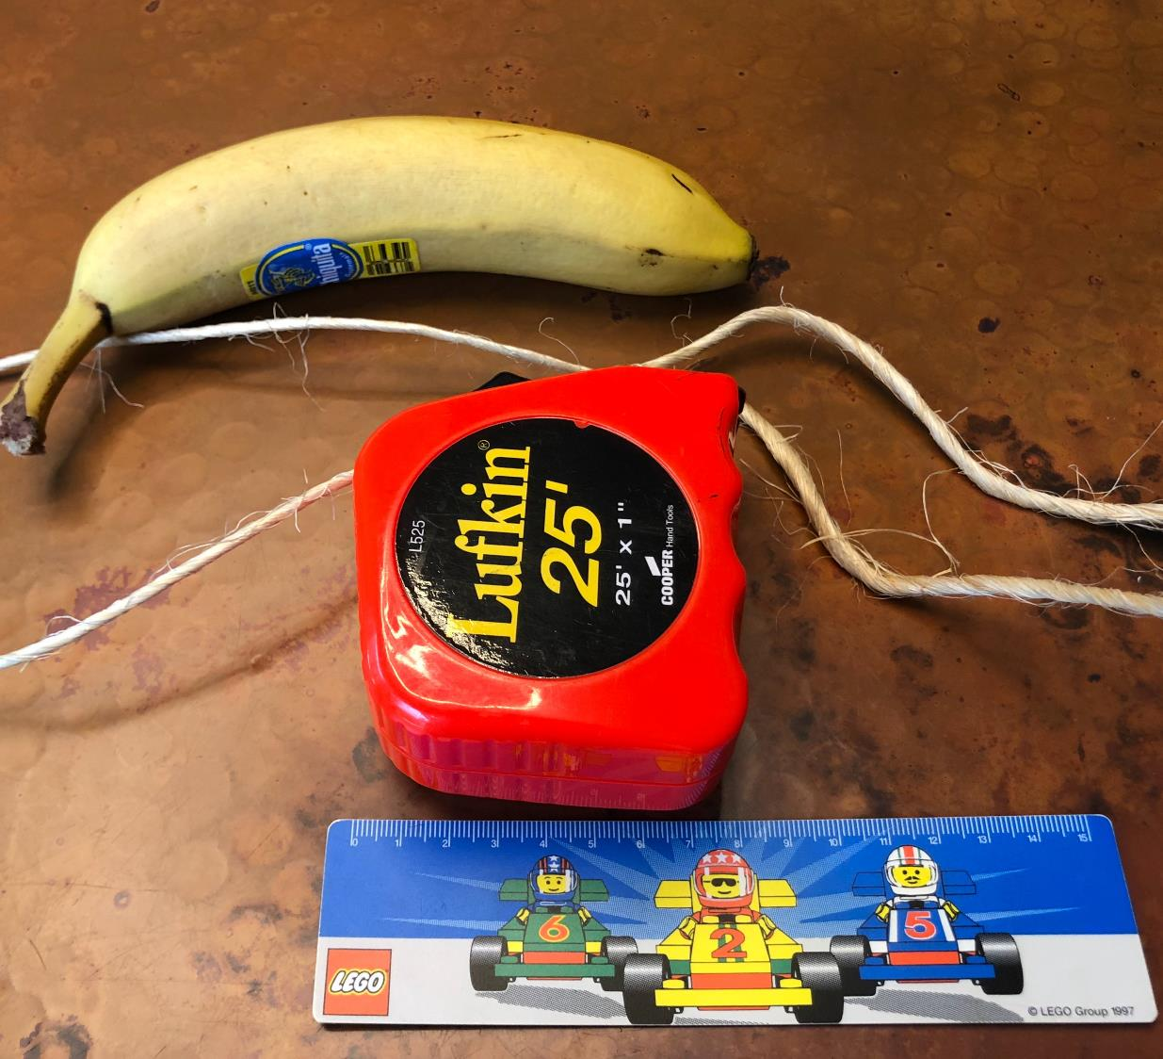
Our measurement (answer) is:

Slide 24
CHANGES for Improving Viral
Load Coverage

Slide 25
Challenges
Care Not at Primary Clinic Site*
Information Flow – Documentation & filing of medical records
Travel related & lack of funds
Social Distancing
Cohort Forming
Client testing is out of sync with assigned cohort
Identification of VL-Eligible Clients
Given multiple cohorts over many years, no reliable method to identify eligible clients
Appointment System
Duplicate Systems – Diary and electronic systems
Lack of reminders – Pt. forgets
Demand Creation / Client Activation
Lack of client ownership of own health & healthcare
Viral load illiteracy
Clinic Processes
Inefficient clinic processes, Long wait time for clients
Viral Load not drawn at appointment
Stockout
*Due to Community Outreach Testing, Visiting Another Site, and/or Site Closure

Slide 26
Think - Process Redesign
CHANGES Menu* (Clinic)
Patient/Client Activation / Education
Appointment System
Medical Information Flow (Outreach)
Improve Clinic Access
Identifying VL Eligible
Setting Appointments
Communication
Reminding of Appointment
Medical
Information used to provide patient/client care
Medical Information communication to patient/client
Efficient Clinic Processes
Effective Clinic Processes
Understands the Why
Access to Own Medical Information
*Other CHANGE, upon request

Slide 27
CHANGES Menu* (Lab)
Think - Process Redesign
Test Result Communication
Redesign Process of Result Delivery / Utilization via SMS or Email - Clinic/Lab Interface
Sample Rejection Communication
Redesign Sample Rejection Process, including notification of sending facility
*Other CHANGE, upon request

Slide 28
Facility Name:
CHANGES to Test
Process Map – Opportunities for Improvement (OFI)
1.
2.
3.
Voice of Customer (VOC)
1.
2.
3.
Root Cause Analysis (RCA)
1.
2.
3.

Slide 29
Deliverable: Link Inputs to
CHANGES to Test

Slide 30
Process Map – Opportunities for Improvement (OFI)
CHANGES to Test
Voice of Customer (VOC)
Root Cause Analysis (RCA)

Slide 31
Process Map – Opportunities for Improvement (OFI*)
CHANGES to Test
1.
2.
3.
Voice of Customer (VOC)
1.
2.
3.
Root Cause Analysis (RCA)
1.
2.
3.
*OFI = Challenges, Problems, Gaps

Slide 32

“If I had an hour to solve a problem…
I'd spend 55 minutes thinking about
the problem and five minutes thinking about solutions.”
Albert Einstein

Slide 33
Facility Name:
CHANGES to Test
A.
Process Map – Opportunities for Improvement (OFI)
1.
2.
3.
Voice of Customer (VOC)
1.
2.
3.
B.
Root Cause Analysis (RCA)
1.
2.
3.

Slide 34
Facility Name:
A. Redesign clinic patient processes, i.e., Client appointment process
CHANGES to Test
Signage is unclear
Patient has to walk around
the clinic to find test results
Next appointment is not written in client’s appointment book
Process Map – Opportunities for Improvement (OFI)
Complaints about long waiting time
Clinic appointment takes the
entire morning and client cannot get to work
3.
Voice of Customer (VOC)
B. Early morning or Saturday clinics
Root Cause Analysis (RCA)
Clinic process is not patient/client friendly
Lab results are taking too
long to get back to the clinic 3.

Slide 35

Breakout Room
Select CHANGE Idea
Based on your 3 inputs
Select a CHANGE Idea
Facilitator to record CHANGE on the Template
Outputs:
q CHANGE Selected

Slide 36
Accept
Accept Zoom Breakout Room Invitation – Click on “Join Breakout Room”
Upon arrival in Breakout Room
Click on Participant List
Unmute your Microphone
Room
Zoom Breakout Rooms
In Breakout Room
Coach to facilitate
Objective: Given your site inputs, select a CHANGE.
Record CHANGE on Template
Room
Return
Return to Main Zoom meeting
Coach sends CHANGE template to Coordinator

Slide 37
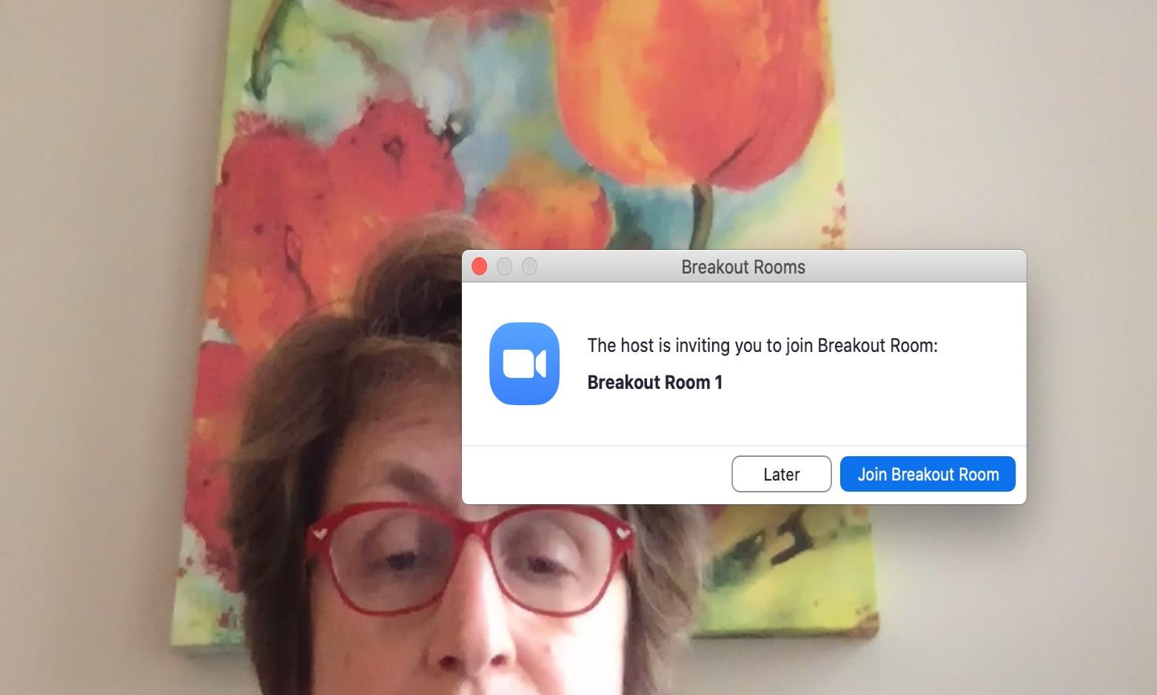
Click Here

Slide 38
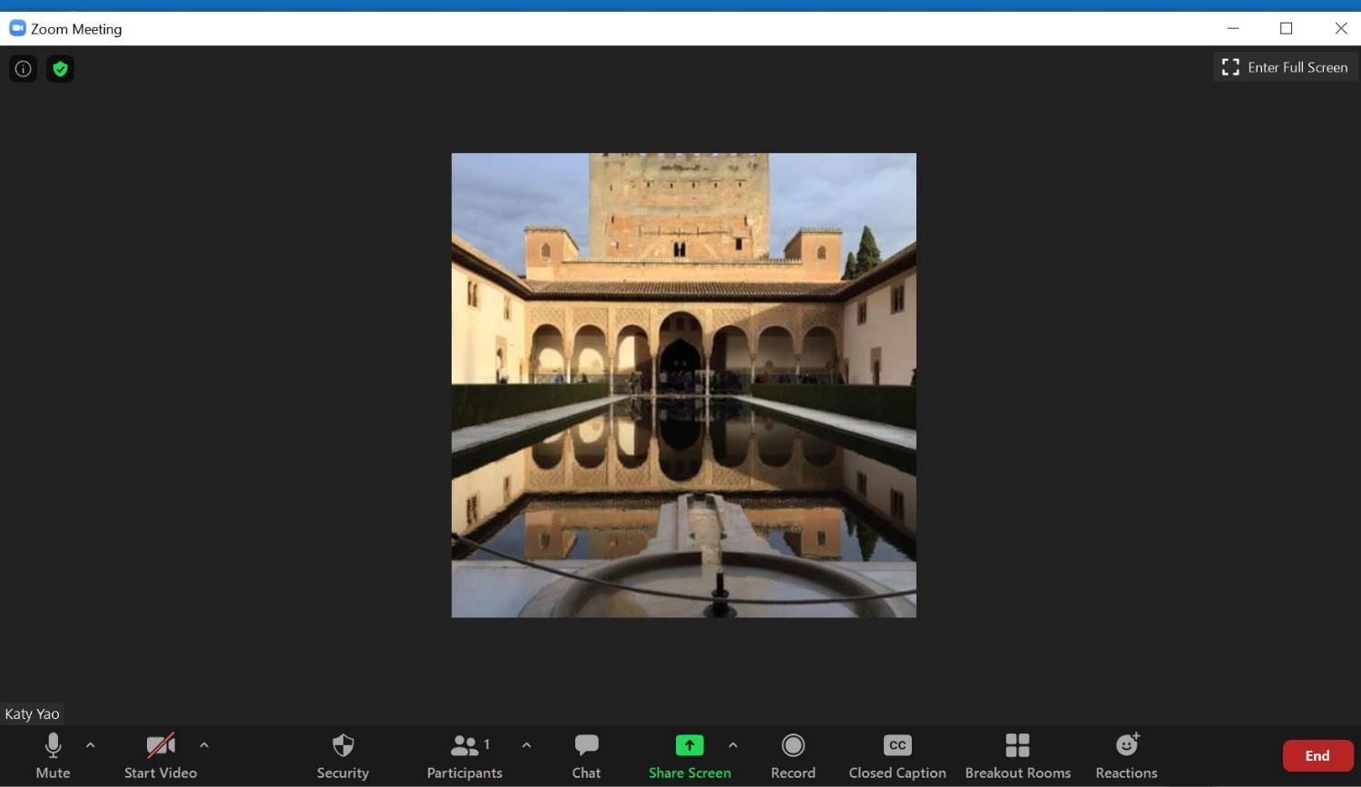
Step 1 – Click Share Screen

Slide 39
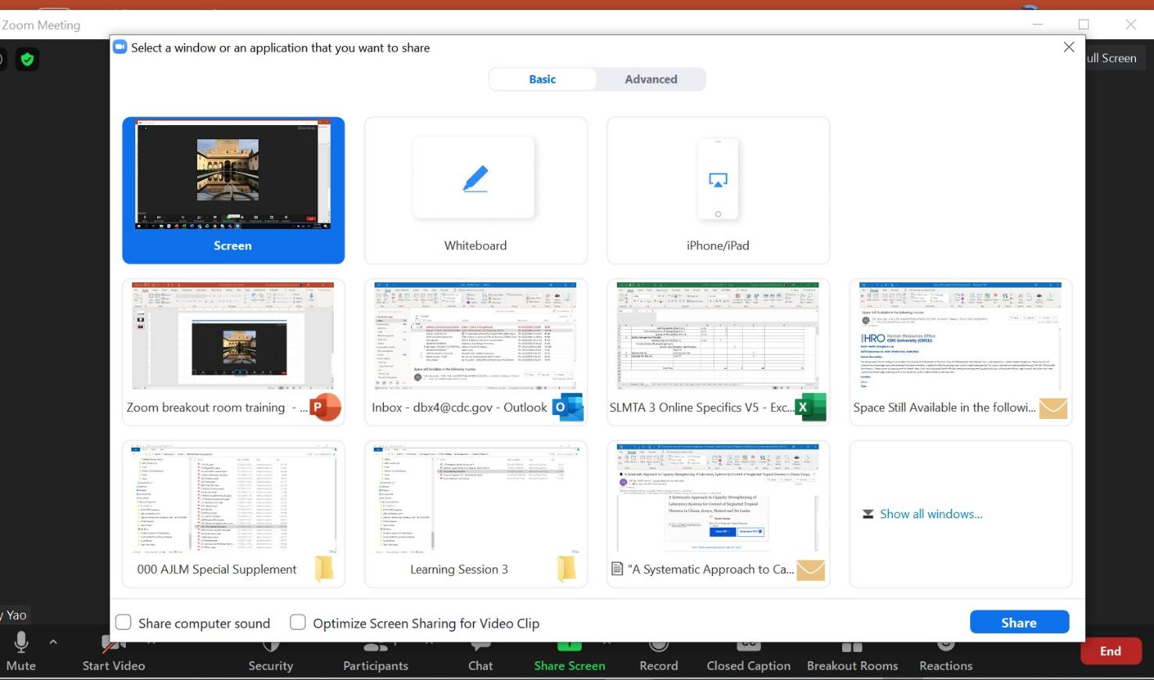
Step 2 – Select Screen or PowerPoint
Step 3 – Click Share

Slide 40
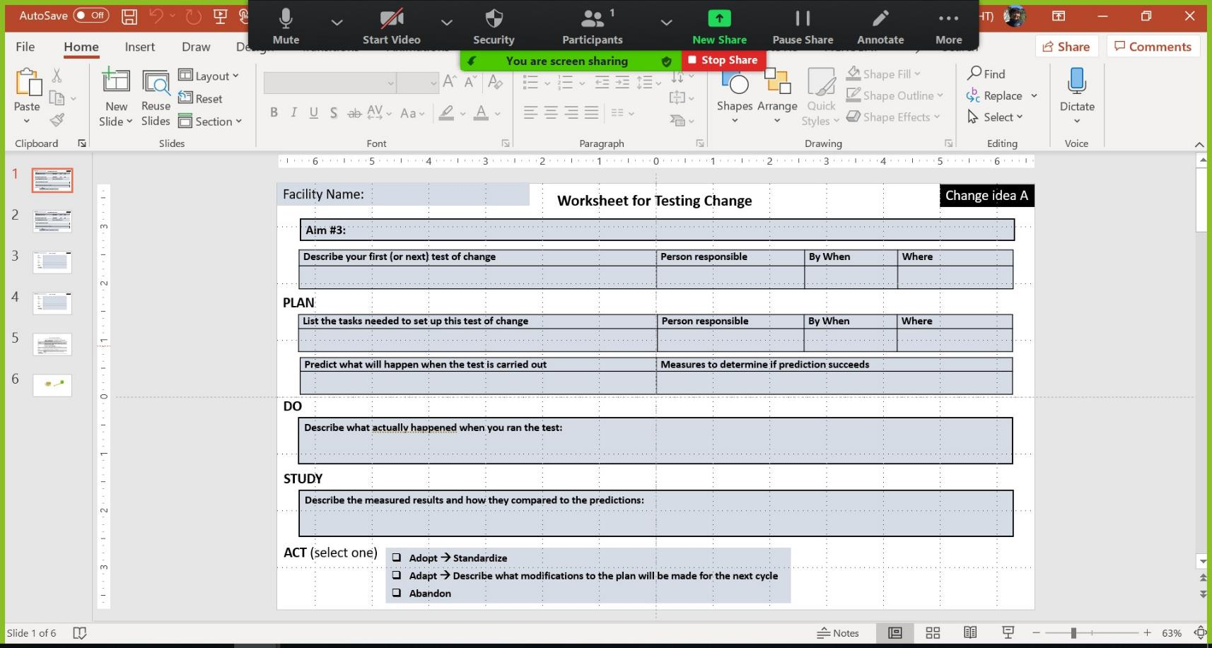
Step 4 – Check the top of your screen to confirm

Slide 41
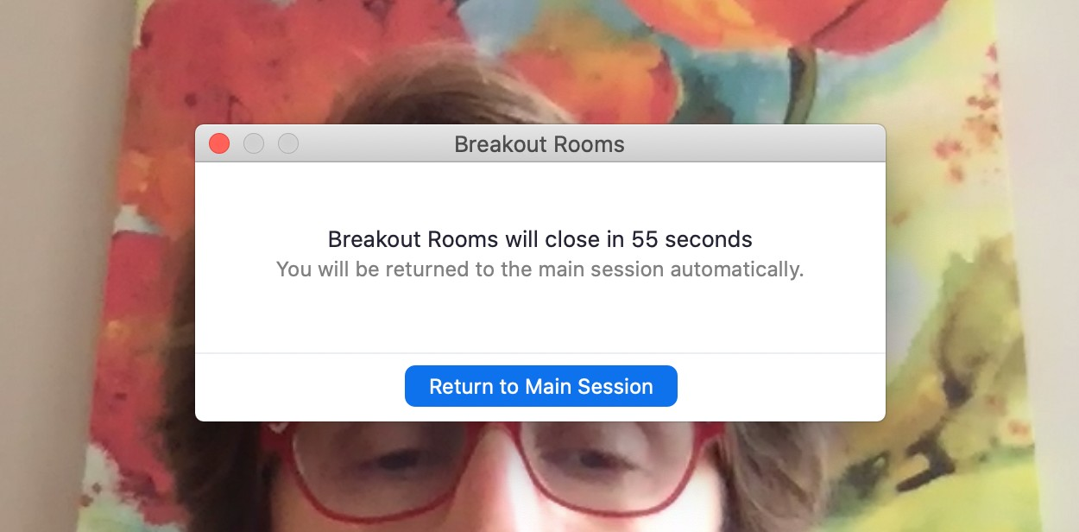
Click Here

Slide 42


. .,
Q Breakout Room 4 Zoom Meeting
)
Talking:
Remaining: 00:29:12
Meeting Topic:
LARC Coaches LS3 Planning Mee
Host:
Kudzai Goredema
Breakout Room:
Breakout Room 4
Passcode:
452848
Participant ID:
432064
Q
•
Join Audio
Share Screen
Computer Audio Connected

Slide 43
PDSA
Step by Step

Slide 44
PDSA
Video

Slide 45
PDSA
Case Study

Slide 46
Facility Name:
Worksheet for Testing Change
PDSA # & Cycle
Aim #3:
Describe your first (or next) test of change | Person responsible | By When | Where
PLAN
List the tasks needed to set up this test of change | Person responsible | By When | Where
Predict what will happen when the test is carried out | Measures to determine if prediction succeeds
DO
Describe what actually happened when you ran the test:
STUDY
Describe the measured results and how they compared to the predictions:
ACT (select one)
q Adopt à Standardize
q Adapt à Describe what modifications to the plan will be made for the next cycle
q Abandon

Slide 47
Facility Name:
Worksheet for Testing Change
Change Idea A
Aim #3: VL Coverage
Describe your first (or next) test of change | Person responsible | By When | Where
Redesign the client appointment process – Appointment creation - Sticker alert for the next appointment | Japhet | Friday, Sept 18 | ART Clinic at the Wakunda Hospital
PLAN
List the tasks needed to set up this test of change | Person responsible | By When | Where
1) Procure stickers | Romana | Tuesday, Sept 15 | Amazon
2) Write a brief SOP | Japhet | Tuesday, Sept 15 | Virtual
3) Select OI/ART nurse – schedule day, time, population, location for test | Phyllis | Tuesday, Sept 15 | Virtual
4) Train Nurse on SOP | Phyllis | Wed, Sept 16 | Virtual
Predict what will happen when the test is carried out | Measures to determine if prediction succeeds
Nurse will find it easy to place stickers Clients will be accepting of the stickers | Will assess client and patient satisfaction with process
Describe what actually happened when you ran the test: Nurse found new CHANGE to be agreeable to clients, but stickers were hard to remove from paper 3 clients said that they thought it would help them to see the appointment better in their book
DO
STUDY
Describe the measured results and how they compared to the predictions:
Nurse not satisfied, so does not agree with predication Client – liked new process
ACT (select one)
q Adopt à Standardize
q Adapt à will purchase new stickers (fortunately only bought one box of old stickers), proceed to Change Idea A, PDSA #2
q Abandon

Slide 48
Facility Name:
Worksheet for Testing Change
PDSA # & Cycle
Aim #3: VL Coverage
Describe your first (or next) test of change | Person responsible | By When | Where
Redesign the client appointment process – SMS Reminders for appointment
PLAN
List the tasks needed to set up this test of change | Person responsible | By When | Where
Predict what will happen when the test is carried out | Measures to determine if prediction succeeds
DO
Describe what actually happened when you ran the test:
STUDY
Describe the measured results and how they compared to the predictions:
ACT (select one)
q Adopt à Standardize
q Adapt à Describe what modifications to the plan will be made for the next cycle
q Abandon

Slide 49
Facility Name:
Worksheet for Testing Change
PDSA # & Cycle
Aim #3: VL Coverage
Describe your first (or next) test of change | Person responsible | By When | Where
Redesign the client appointment process – New Process with electronic appointment, sticker communication, and SMS reminder
PLAN
List the tasks needed to set up this test of change | Person responsible | By When | Where
Predict what will happen when the test is carried out | Measures to determine if prediction succeeds
 | Viral load samples drawn (Metric 2) & results recorded in green books (Metric 3)
DO
Describe what actually happened when you ran the test:
STUDY
Describe the measured results and how they compared to the predictions:
ACT (select one)
q Adopt à Standardize
q Adapt à Describe what modifications to the plan will be made for the next cycle
q Abandon

Slide 50
Breakout Room
Create PDSA Plan
Based on your selected CHANGE
Create a PDSA Worksheet for the PDSA that you will test next week
Facilitator to record PDSA Plan on the Template
Outputs:
q PDSA Worksheet

Slide 51
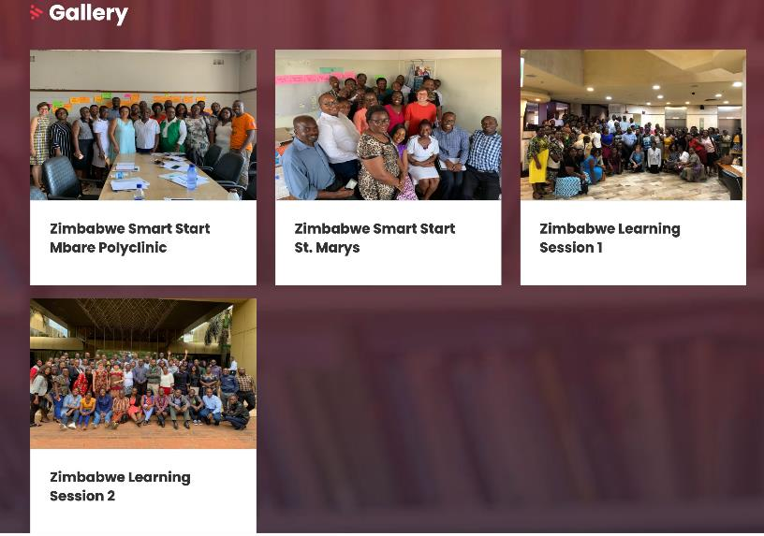
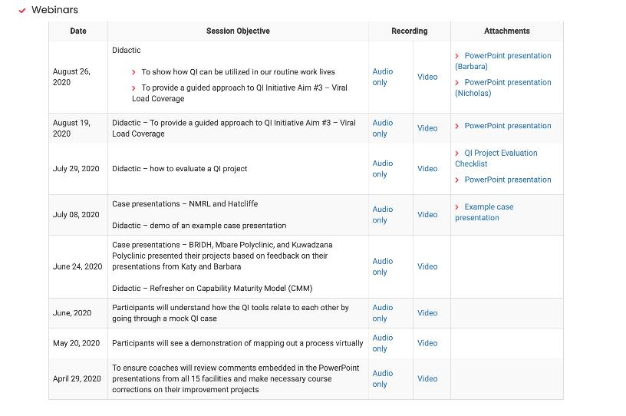
Missed a Meeting?
Check out the recorded sessions on the LARC Website:
https://www.larccqi.org/impl ementations/zimbabwe

Slide 52
Data Collection Demonstration:
Video by Mr. Japhet Mabuku

Slide 53

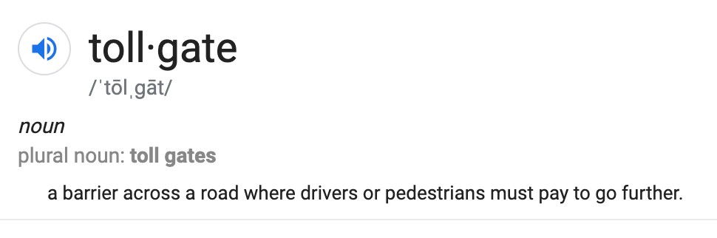
The Six Sigma DMAIC problem solving methodology is accomplished in five phases, or steps: Define, Measure, Analyze, Improve and Control. Between each phase or step many companies employ a “tollgate” to control the
process. Only when the person leading the project confirms that the team has successfully completed the previous phase may they pass the tollgate and move to the next phase.

Slide 54

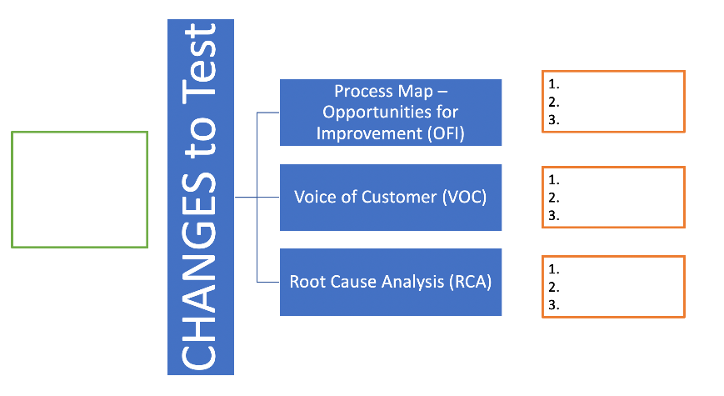
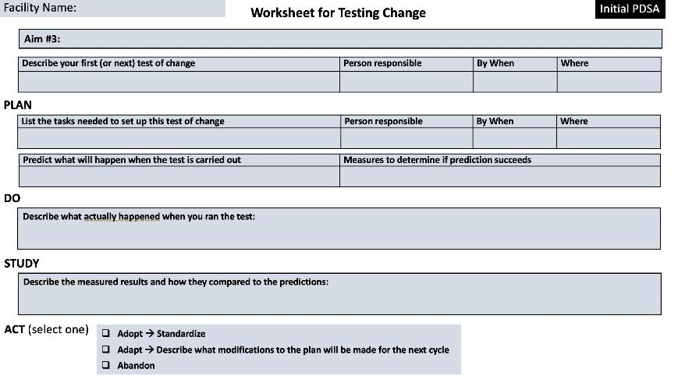
Deliverables for Today
PDSA Worksheet / Plan
Select CHANGE

Slide 55

Thank You
Please take the poll!

